Slide 1
Sequence Reinforcement Learning
Intelligent Systems Group 8

Slide 2
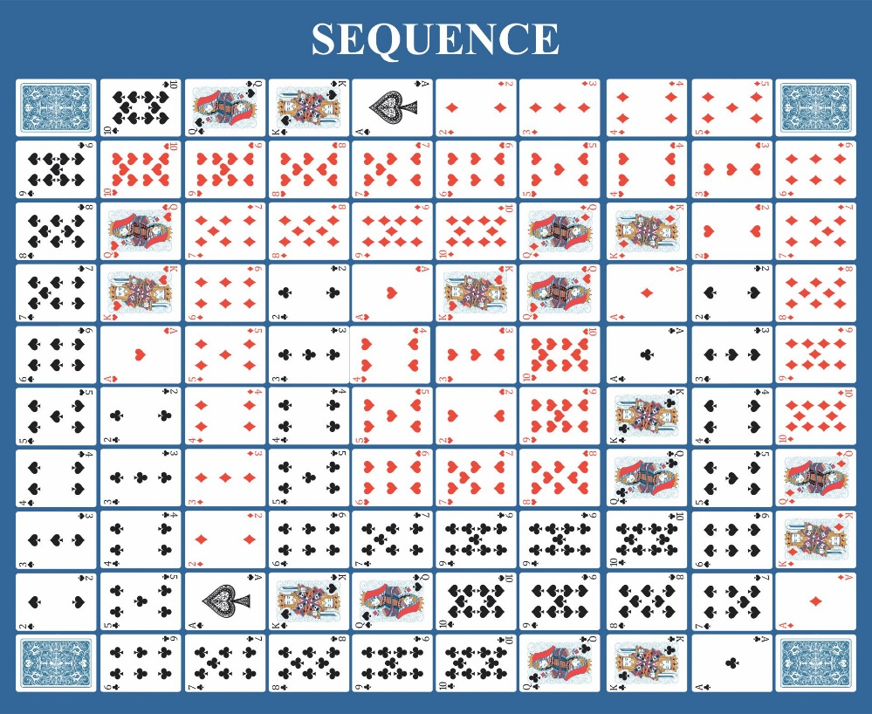
The Game of Sequence
Each player has 5 cards in their hand.
Goals is to get sequence of 5 tokens on the board.
One-eyed Jacks remove opponent's token
Two-eyed Jacks act as wild.

Slide 3
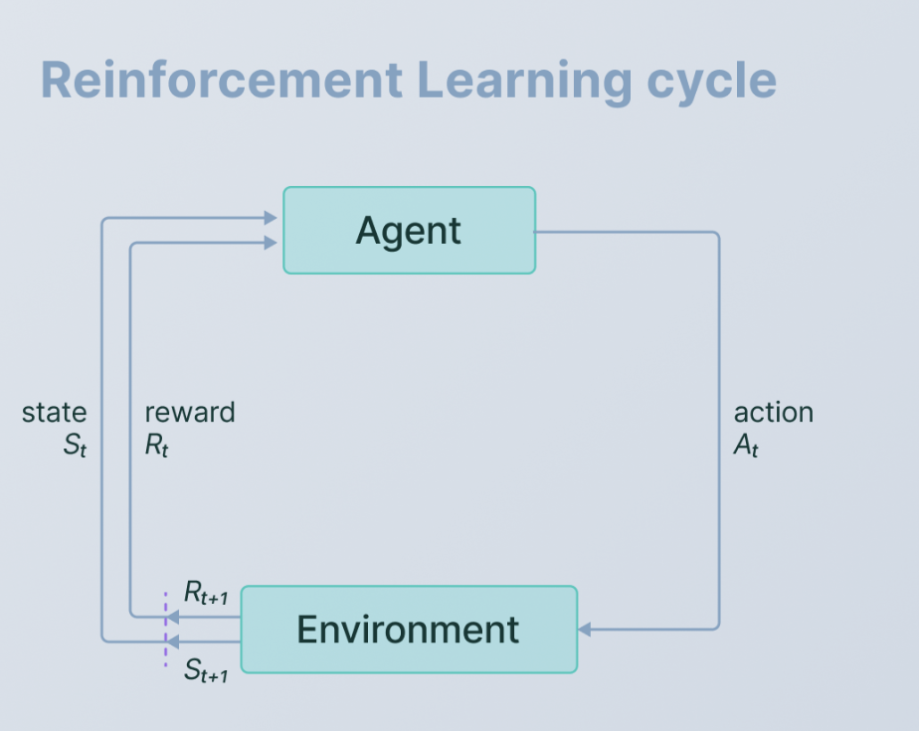
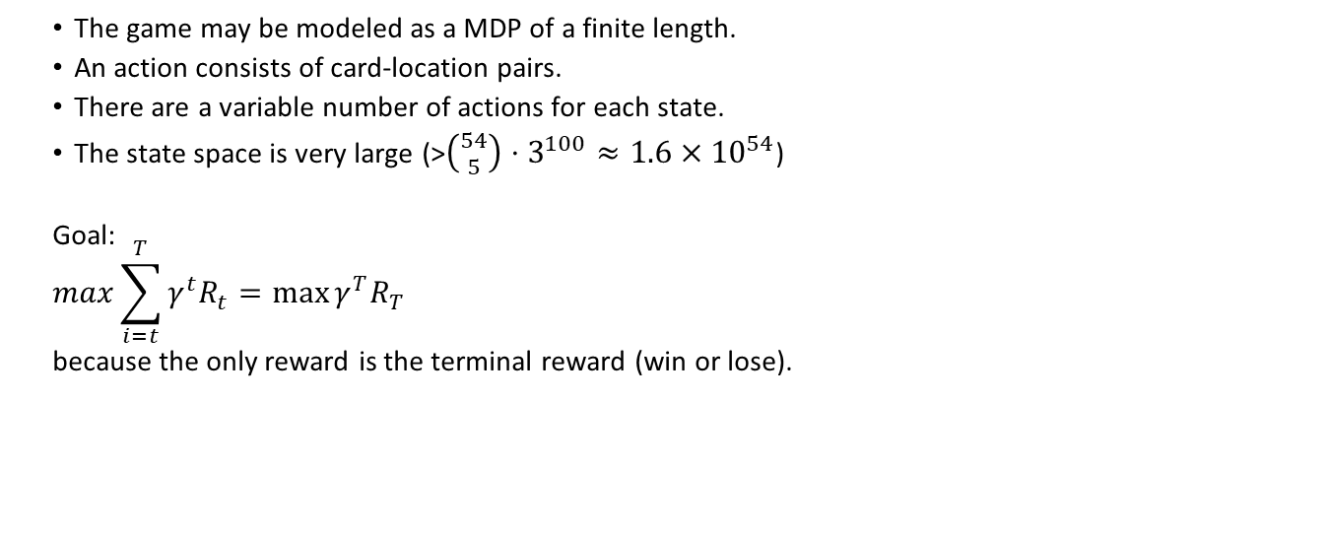
RL Formalism
The game may be modeled as a MDP of a finite length.
An action consists of card-location pairs.
There are a variable number of actions for each state.
The state space is very large (>${\left({54 \atop 5}\right)⋅3}^{100}≈1.6×{10}^{54}$)
Goal:
$$\max{\sum_{i=t}^{T}{γ^{t}R_{t}}}=\max{γ^{T}R_{T}}$$
because the only reward is the terminal reward (win or lose).

Slide 4
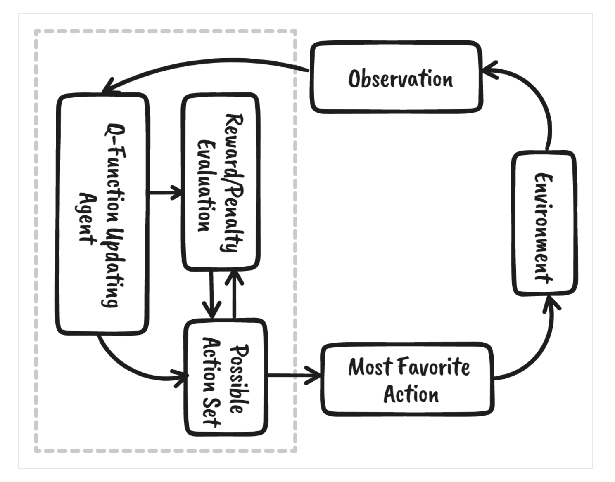
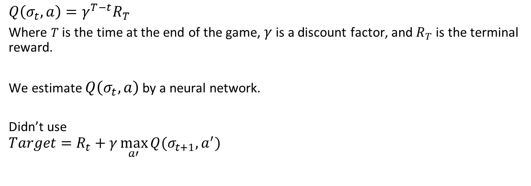
Q-Learning Approach
$$Q\left(σ_{t},a\right)=γ^{T−t}R_{T}$$
Where $T$ is the time at the end of the game, $γ$ is a discount factor, and $R_{T}$ is the terminal reward.
We estimate $Q\left(σ_{t},a\right)$ by a neural network.
Didn’t use
$$Target=R_{t}+γ\max_{a′}{Q(σ_{t+1},a^{′})}$$

Slide 5
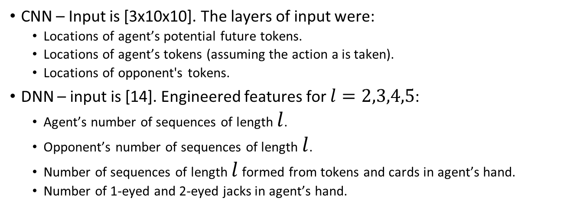
Models
CNN – Input is [3x10x10]. The layers of input were:
Locations of agent’s potential future tokens.
Locations of agent’s tokens (assuming the action a is taken).
Locations of opponent's tokens.
DNN – input is [14]. Engineered features for $l=2,3,4,5$:
Agent’s number of sequences of length $l$.
Opponent’s number of sequences of length $l$.
Number of sequences of length $l$ formed from tokens and cards in agent’s hand.
Number of 1-eyed and 2-eyed jacks in agent’s hand.

Slide 6
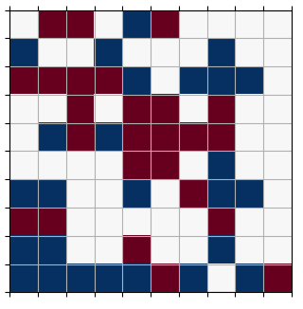
Experiments
We considered 5 agents:
R: chooses moves randomly.
E: chooses moves according to an engineered heuristic function.
QD: chooses moves according to the Q-learning dense network.
QC: chooses moves according to the Q-learning CNN network.
H: humans choose moves.
Agents play against each other.

Slide 7
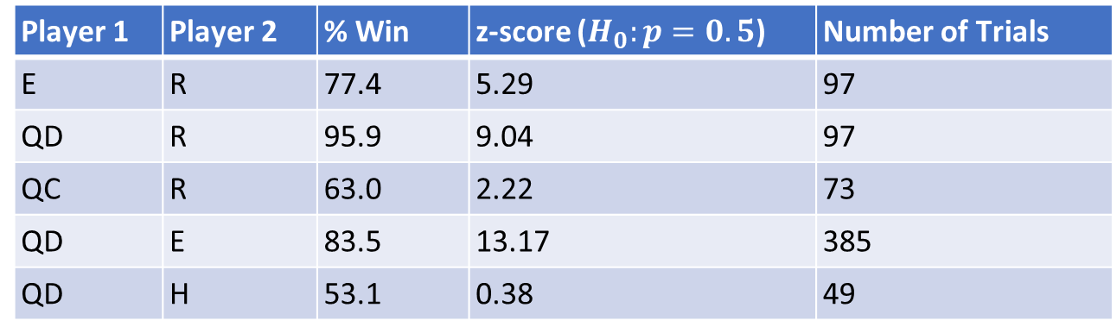
Results
Player 1 | Player 2 | % Win | z-score ($H_{0}:p=0.5$) | Number of Trials
E | R | 77.4 | 5.29 | 97
QD | R | 95.9 | 9.04 | 97
QC | R | 63.0 | 2.22 | 73
QD | E | 83.5 | 13.17 | 385
QD | H | 53.1 | 0.38 | 49
*There is a significant amount of randomness involved in sequence so no player should have a 100% win-rate.

Slide 8
Conclusions
Q-learner DNN worked very well.
CNN requires more training and optimization
Adam optimizer worked much better than SGD

Slide 9
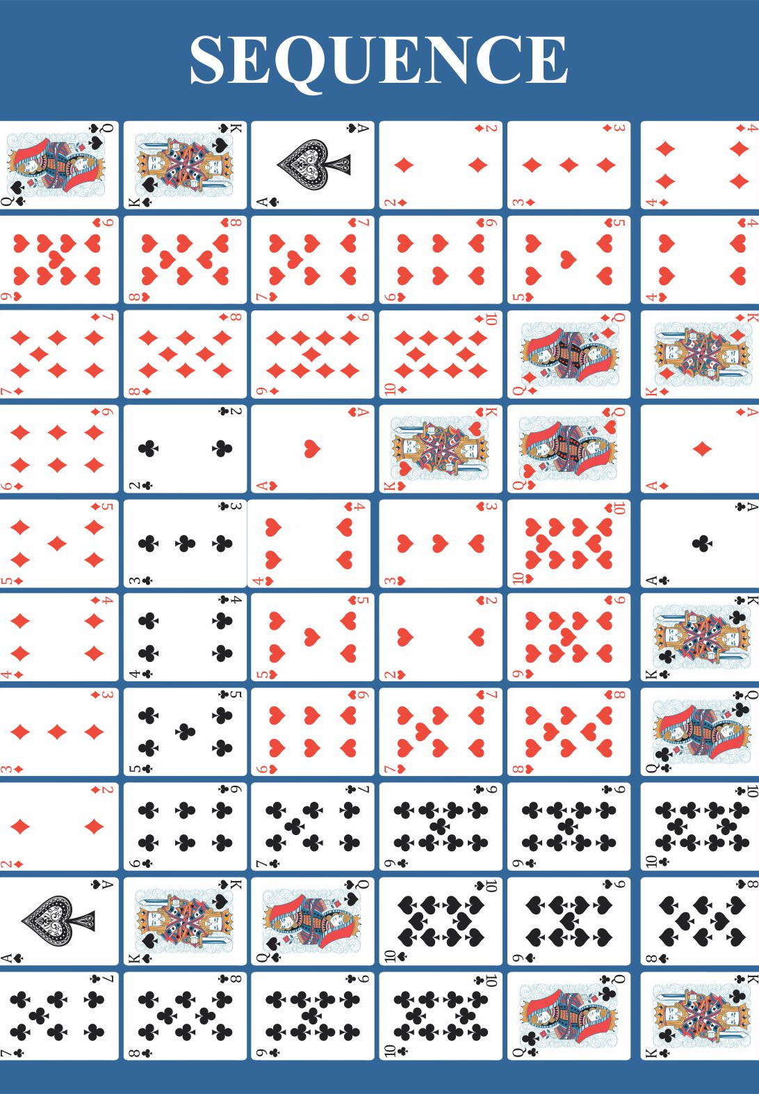
Thank You!! Any questions?

